Slide 1

Introduction
to
Computer Science
CS101.3
Lecture #10
Pramudya Thilakaratne pramudya.h@nsbm.ac.lk
Lecturer
Faculty of Computing
NSBM Green University

Slide 2
Welcome to Lecture 10!
Take your notebooks and prepare
You can ask questions via either chat message or over the mic.
When you are not using the mic please mute it.

Slide 3

From Last Week
Computer Storage Structure
Hard Disk Drive

Slide 4
Computer Storage Structure
Computer storage contains many computer components that are used to store data. It is traditionally divided into primary storage and secondary storage.

Slide 5
Secondary Storage
Secondary or external storage is not directly accessible by the CPU.
The data from secondary storage needs to be brought into the primary storage before the CPU can use it.
Secondary storage contains a large amount of data permanently.
The different types of secondary storage devices are
Hard Disk
Floppy Disk
Memory Cards
Flash Drives
Compact Disk (CD)

Slide 6
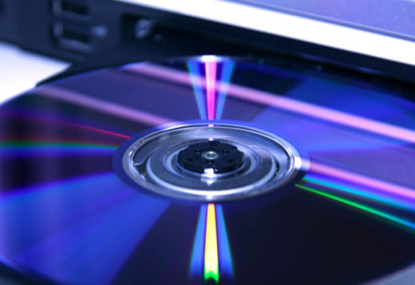
Optical Disk
Lecture #10

Slide 7
Optical Disk
An Optical disk is primarily used as a portable and secondary storage device.
It can store more data than the previous generation of magnetic storage media, and has a relatively longer lifespan.
Compact Disk (CD), Digital Versatile Disk / Video Disk (DVD) and Blu-ray disks are currently the most commonly used forms of Optical Disks.

Slide 8
Benefits of Optical Disks
Distribute software to customers
Store large amounts of data such as music, images and videos
Transfer data to different computer devices
Back up data from a local machine

Slide 9
Compact Disk (CD) Characteristics
The first CD-R was published by Sony and Philips in 1988.
CDs store up to 700 MB of data or 80 min of audio.
Compact disk can be categorized into two sections
Compact Disk Recordable (CD-R)
Compact Disk Rewritable (CD-RW)

Slide 10
CD - R
A CD-R, or compact disc – recordable, allows you to copy music or files one time.
In other words, once you copy a song or set of songs from your computer hard drive onto the disc, you can no longer make any changes to the CD – R.
The recording becomes permanent.

Slide 11
CD - RW
A CD– RW, or compact disc – rewritable, allows you to burn music or files multiple times.
In other words, you can burn one album of music onto CD-RW and you can erase and re burn another album of music on another day.
A Standard CD – RW can hold between 74 and 80 mins of music.

Slide 12
How data stores inside CD - R
In Optical discs (CD / DVD / Blu-Ray) data store as 1s and 0s
When considering CD - R it has no bumps or flat areas
smooth reflective metal layer, which rests on top of a layer of photosensitive dye.
In a blank disc, the dye is transparent
When storing data inside CD-R what happened is burner will burn some spots and others remain as same as it is to store 1s and 0s in it.

Slide 13
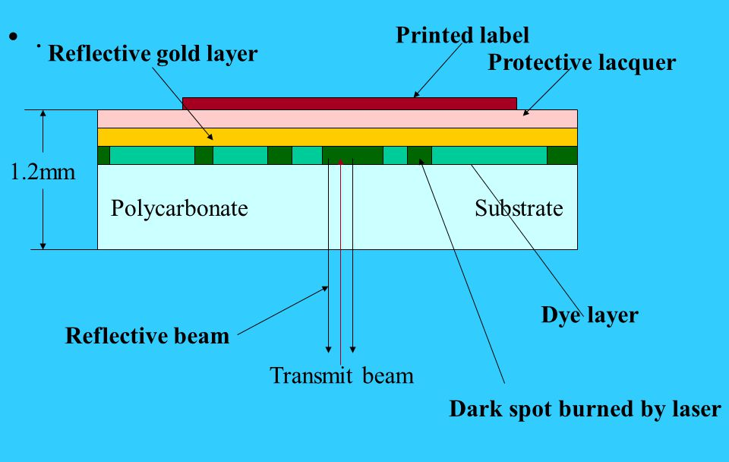
Cross Section of CD - R

Slide 14
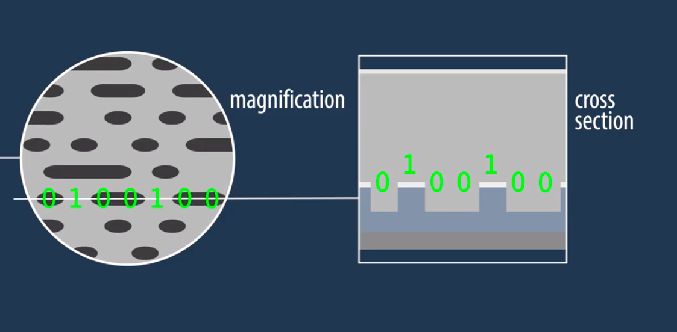
How data stores inside CD - RW
When storing data inside CD – RW it used phase changing technology
A CD-RW disc, in contrast, does not have the traditional dye-and-metal coating. Instead, it is coated with a metal alloy (containing silver, indium, antimony, and tellurium, in case you’re curious) with reflective properties that change depending on the temperature to which you heat it.
The lands represent 1 and the pits represent 0 in binary computing.

Slide 15

How to read data which inside a CD

Slide 16
DVD
Short form of digital versatile disc or digital video disc, is DVD
DVD disc capable of storing a significant amount of data when comparing with CD
DVDs are first sold in 1996

Slide 17
The history of DVD
In 1993, there were two video disc formats being developed
MMCS (Multimedia Compact Disc)
SD (Super Density) disc
Sony and Philips are the backers of MMCD and Hitachi, JVC, Mitsubishi and Pioneer are the backers of SD.
To avoid a video format war above companies decided to partner with each others and developed DVD
The first DVD was the movie “Twister” which released in March 1996.

Slide 18
How much data can a DVD hold?
One of the most common DVDs is the single-sided, single-layer disc which capable of holding 4.7 GB
The single-sided, double-layer disc is capable of holding between 8.5 – 8.7 GB
The double-sided, single-layer disc is capable of holding 9.4 GB
Although rare, the double-sided, double-layer disc is capable of holding up to 17.08 GB

Slide 19
Difference between CD & DVD
Physically, a DVD and CD look the same.
Both discs are the same size and have one labeled side.
Main difference is the amount of data which can store inside DVD is greater than CD

Slide 20
Can DVD drives read CD?
YES
All DVD drives are capable of reading CDs and DVDs
And also if you have a DVD burner you can also write on CD-Rs and CD-RWs and writable DVDs.

Slide 21
Task
How to store data inside DVD
How to read data which inside DVD

